Slide 1
POWER POINT ACTIVITY RELATED TO DINOSAURS
Further Reading: HERBIE AND THE T. REX by Charlotte Sebag-Montefiore
(All royalties are given to the NHS)
Parental involvement: This is recommended
Minimum age: 4. No maximum age.
Specified Learning Outcomes:
Increased knowledge of dinosaurs and specifically, the diplodocus; the T. Rex; the ankylosaurus; the stegosaurus; and the pachycephalosaurus
Increased knowledge of the timeline of dinosaurs
Increased knowledge of what humans have in common with dinosaurs

Slide 2
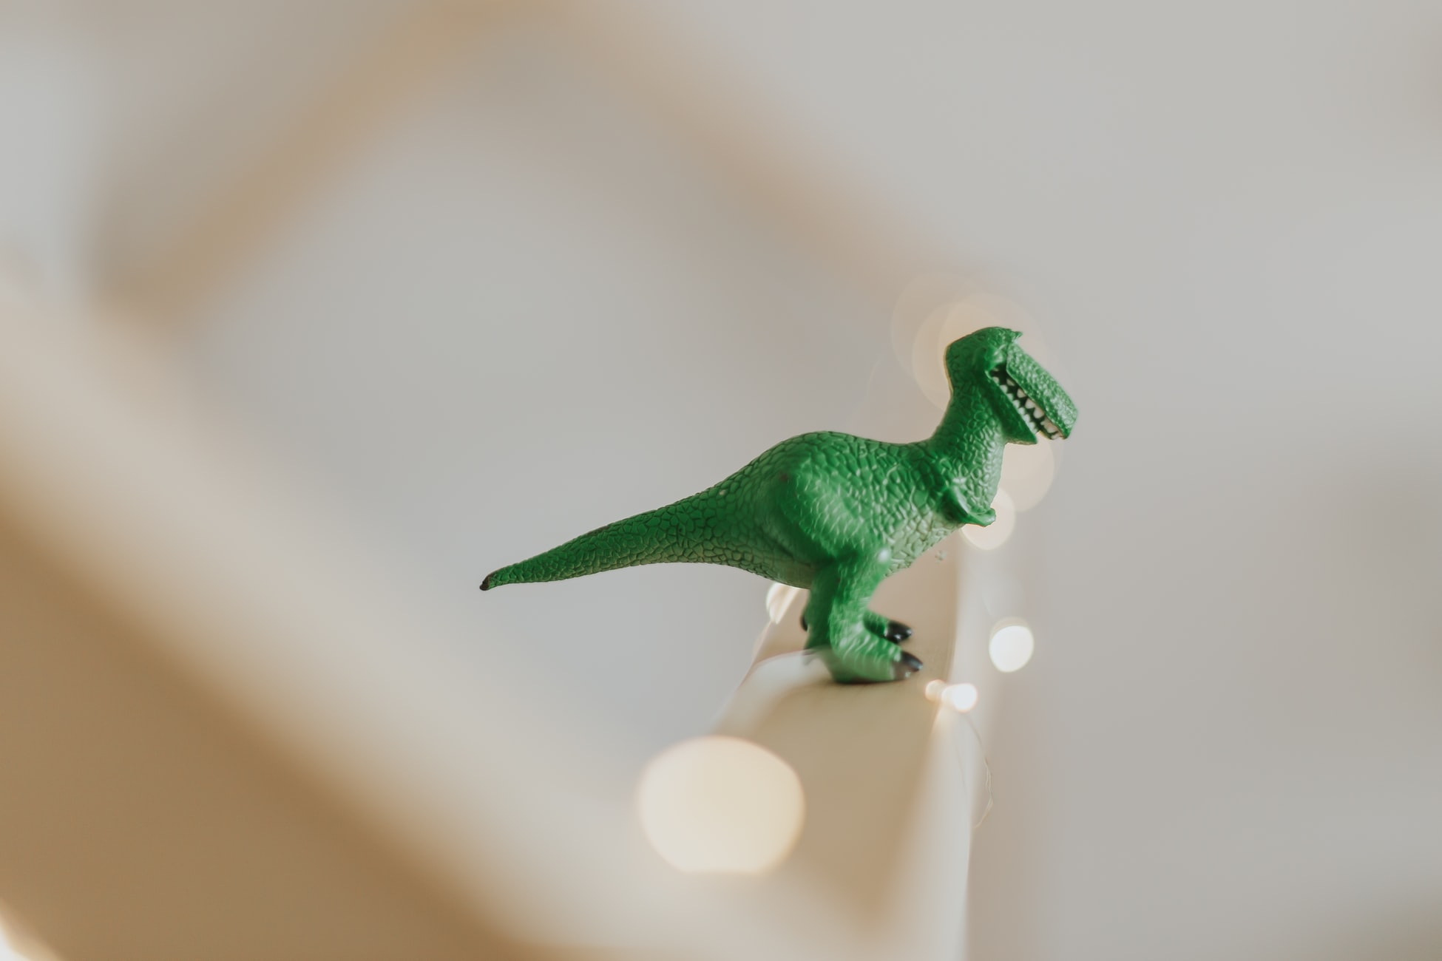
Dinosaurs!
A closer look at these great beasts and
some of the smaller ones…

Slide 3
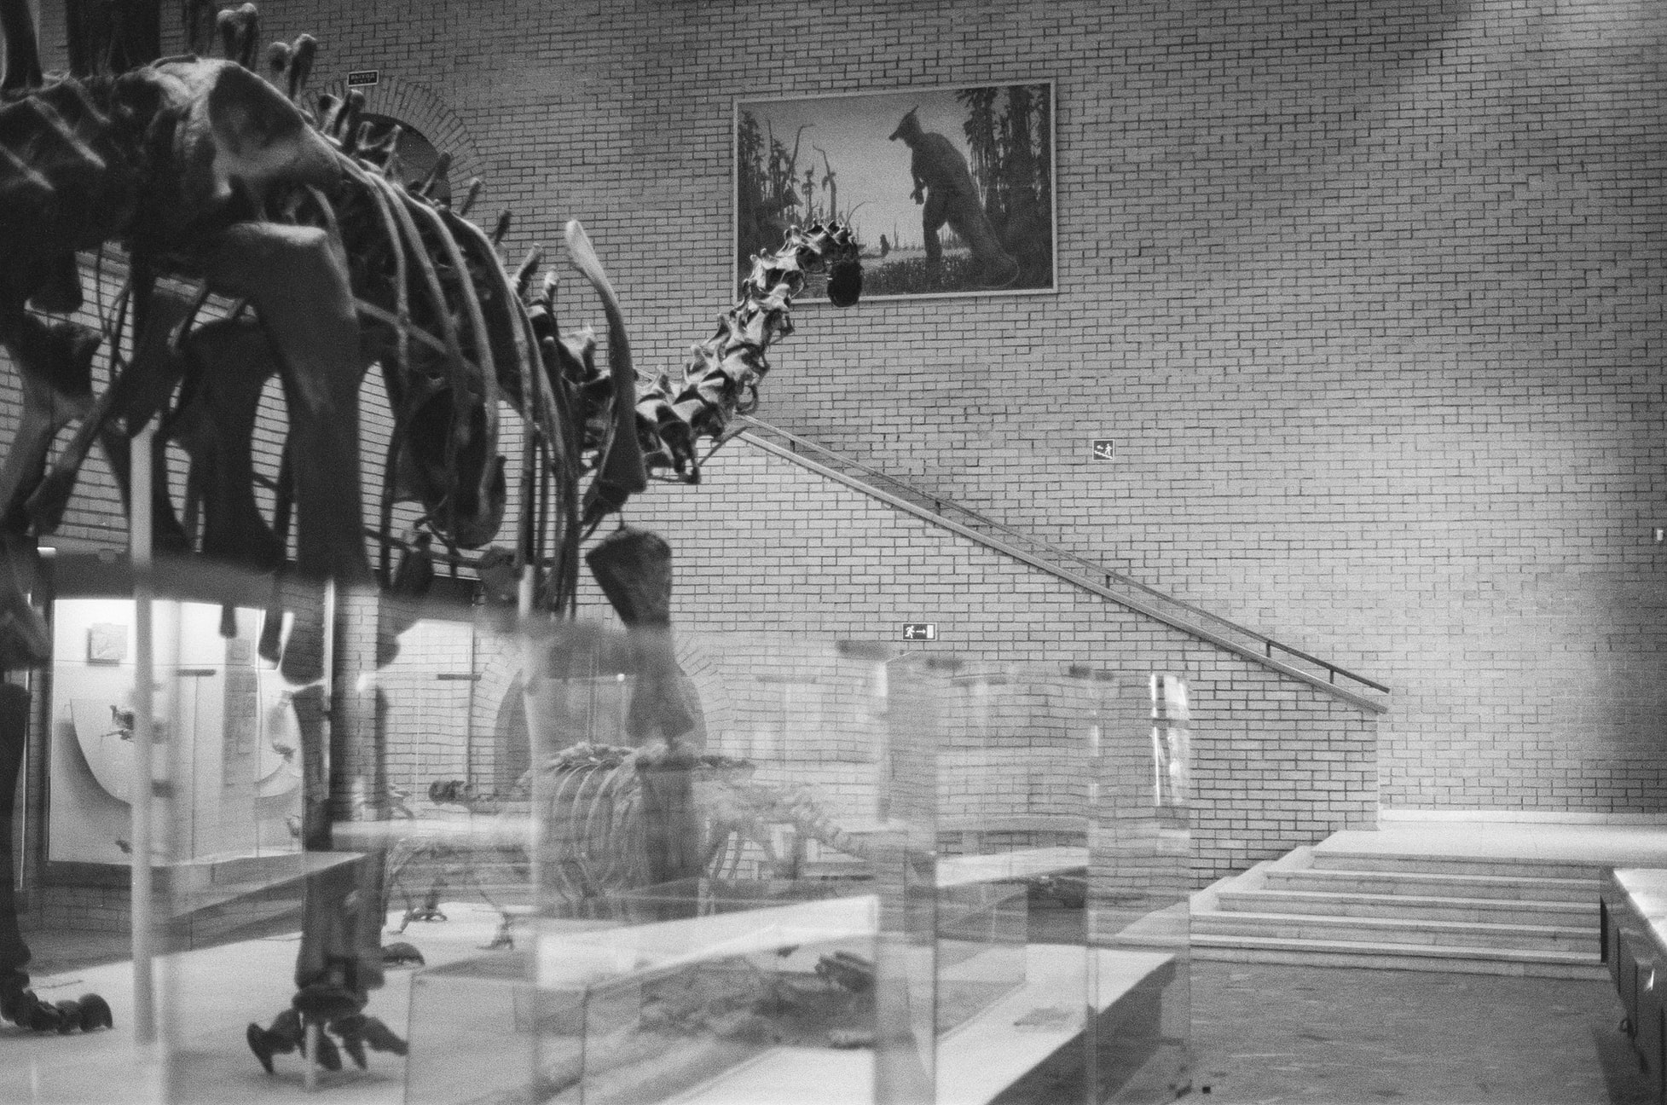
Before we start here is the timeline of Dinos!

Slide 4
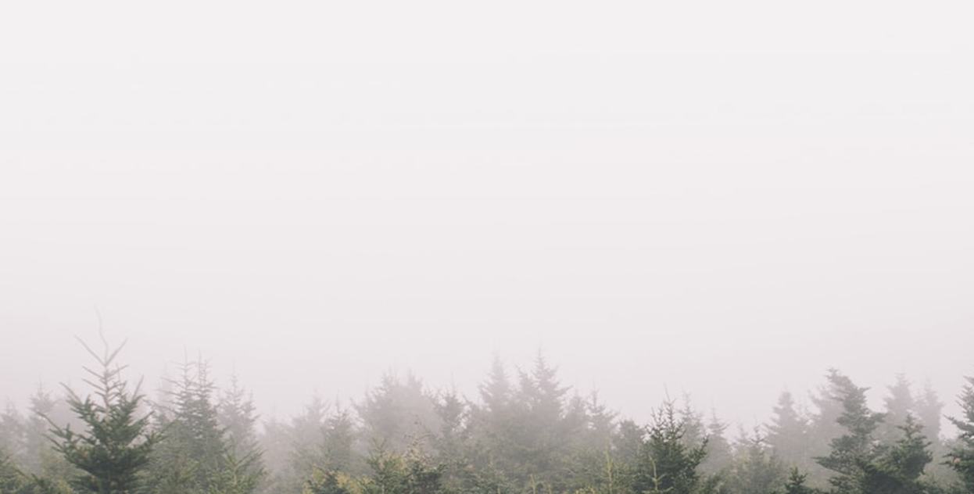
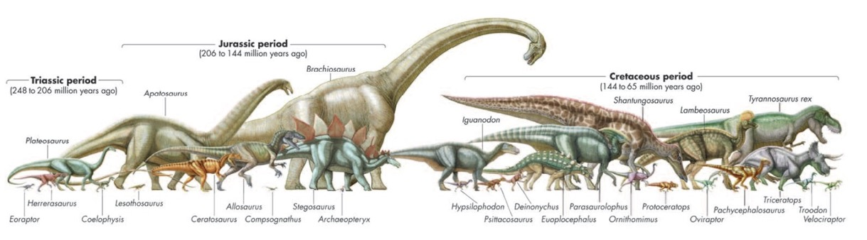
There were three main periods.
First was the Triassic period - 237–201 million years ago
In the middle is Jurassic - 201–145 million years ago
And last was Cretaceous - 145–66 million years ago

Slide 5
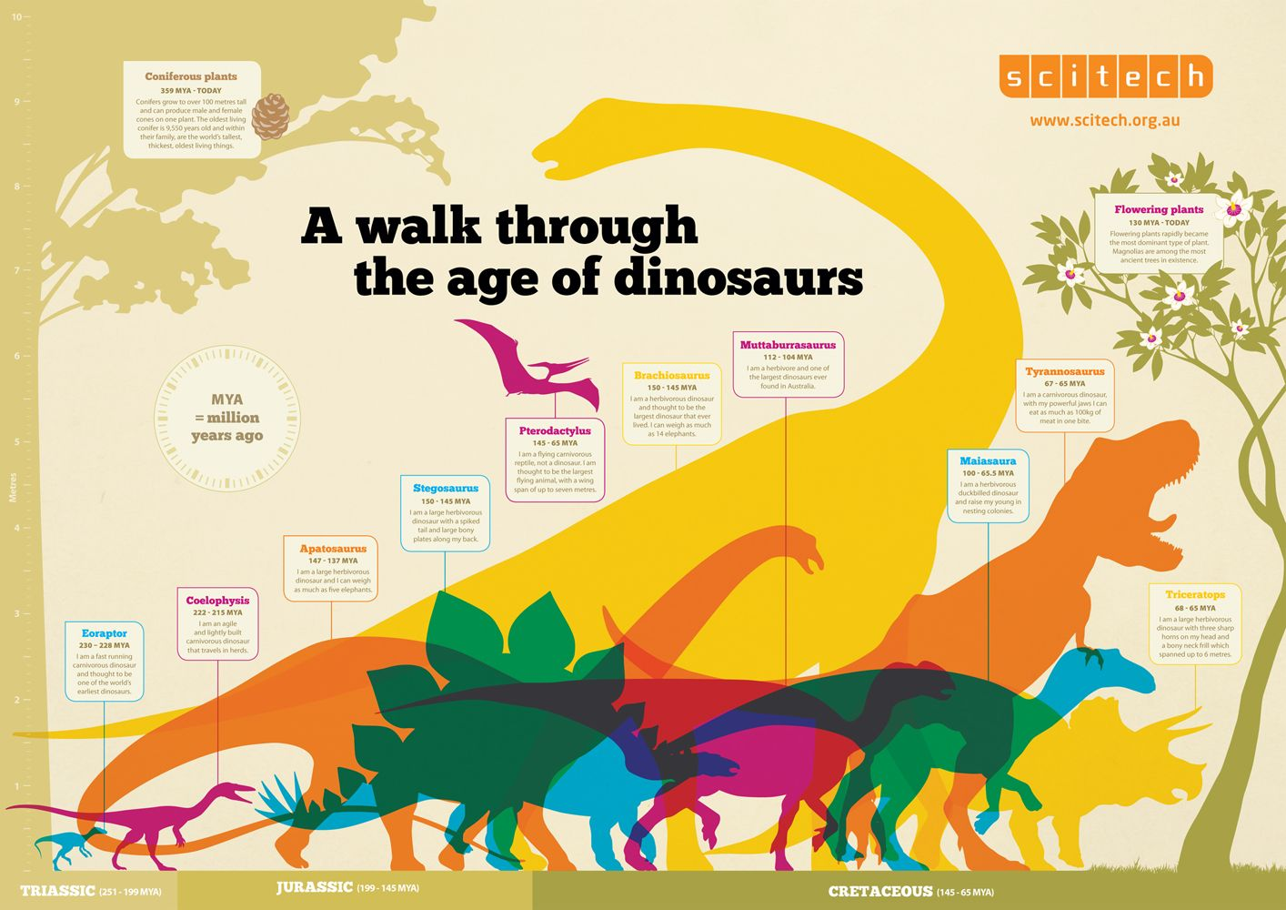

Slide 6
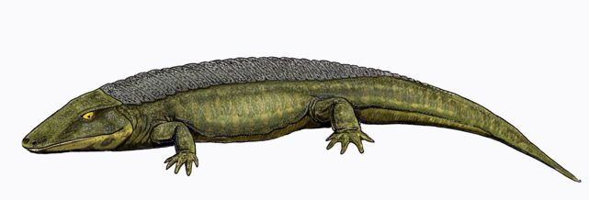
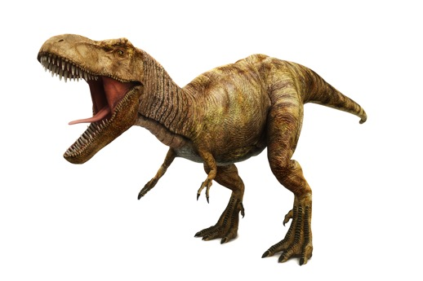
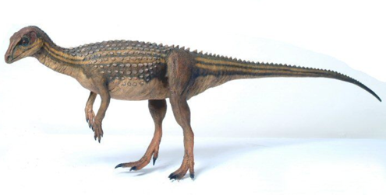
What do we have in common with Dinosaurs?
Common ancestors about 320 million
years ago: there were some reptile-like
animals (reptiliomorpha)
Two Legs (Bipeds): some of the most
successful dinosaurs were bipeds - like us.
A Biped is a two-footed animal that often
has arms to grasp things with

Slide 7
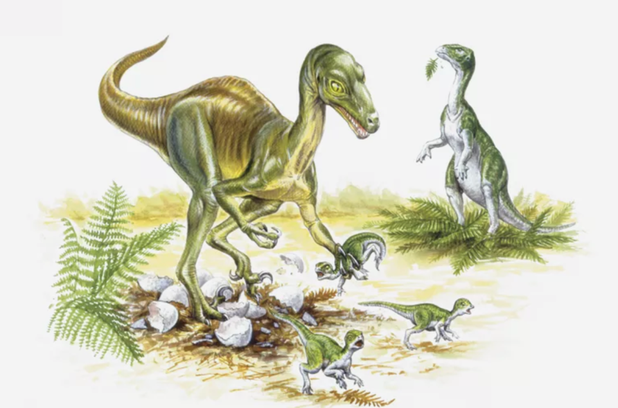
Warm-blooded: Two legged (biped)
dinosaurs were very likely to be
warm-blooded. This applies to modern
dinosaurs (the birds).
Both eyes work together
(binocular vision): the Troodon had
eyes which worked together.
Development of a bigger brain:
Some dinosaurs had brains of the
same size to body ratio as birds
(ie the cassowary).

Slide 8
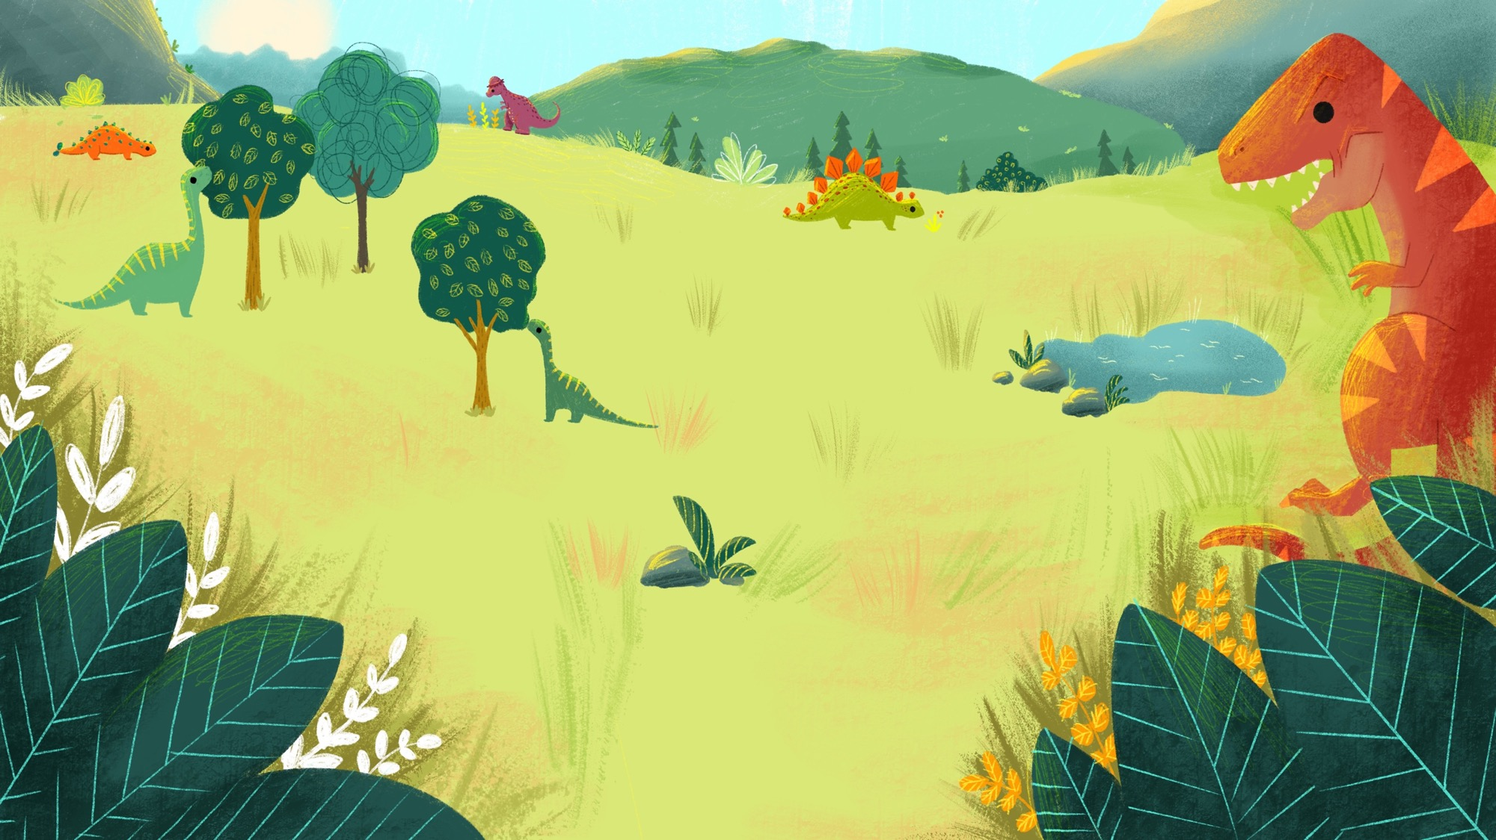
Let’s take a closer look at the dinosaurs in
Herbie and the T. Rex

Slide 9
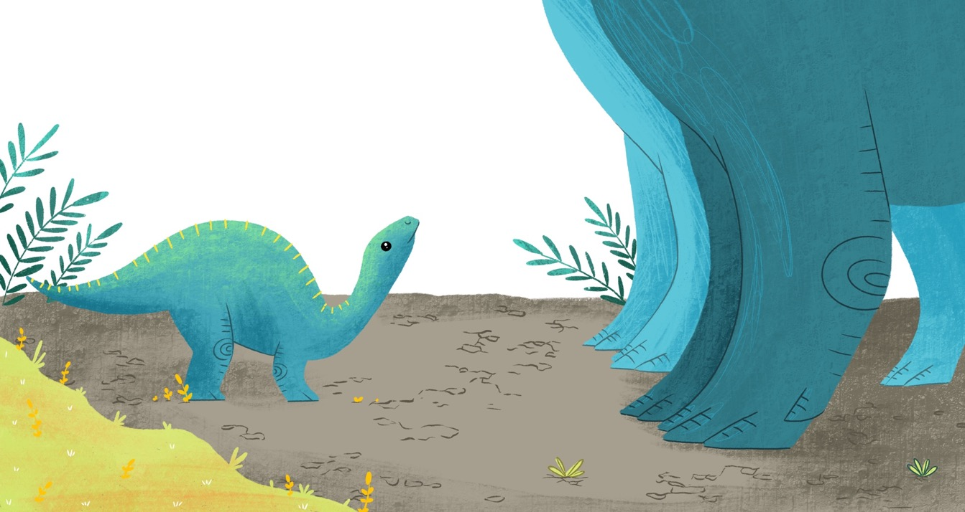
Can you guess what dinosaur Herbie is?

Slide 10
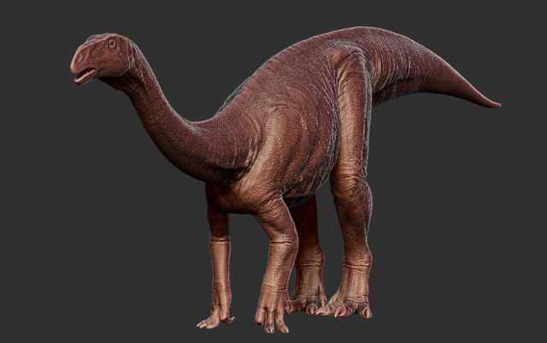
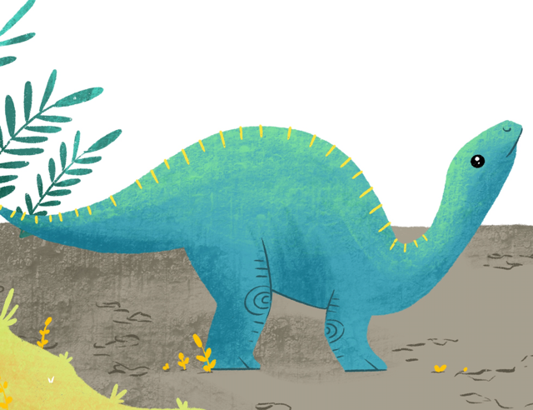
Herbie is a Plateosaurus!
Plateosaurus translates roughly to 'broad lizard’.
They had big lungs and took deep breaths, and lived during the Late Triassic period.
They had grasping hands, sharp eyes and a heavy tail. They were herbivores.
Fully grown they were about 4.8 - 10 meters. Over three times as big as an average man!

Slide 11
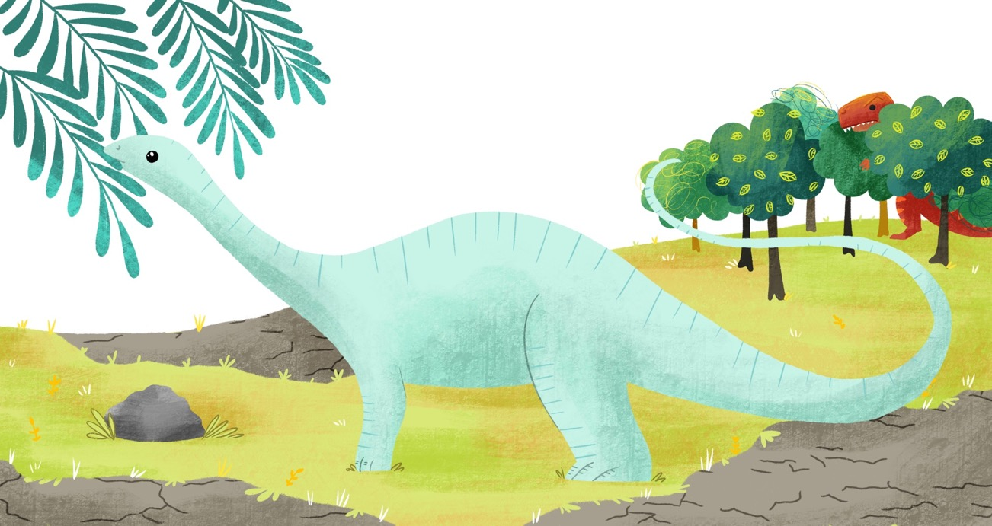
Next, can you guess what Dippy is?

Slide 12
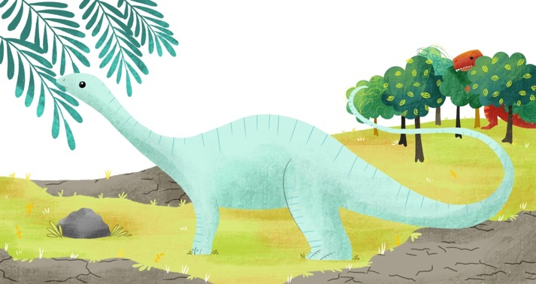
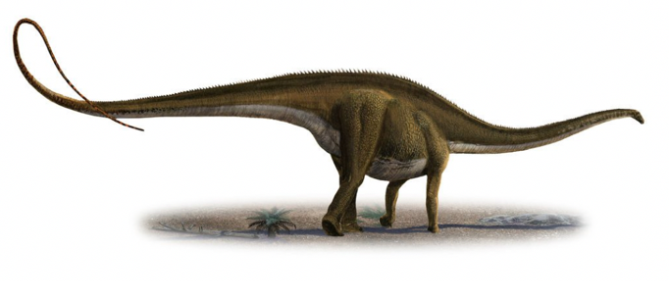
Dippy is a Diplodocus!
They lived in what is now mid-western North America at the end of the Jurassic period
For many years, it was the longest dinosaur known (the longest is a Amphicoelias which is almost double as long) they were 175 feet, that's half the size of a football field!
They weighed 20 or 25 tons! A normal elephant weighs around 5. So that’s heavy!

Slide 13
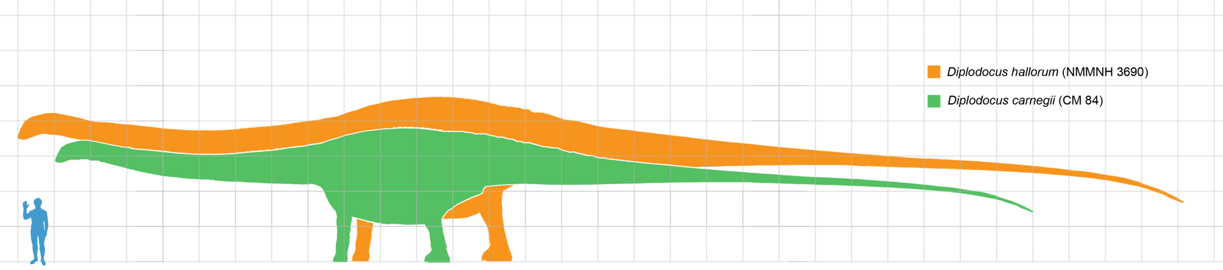
To show you a scale, this is how big Dippy is!

Slide 14
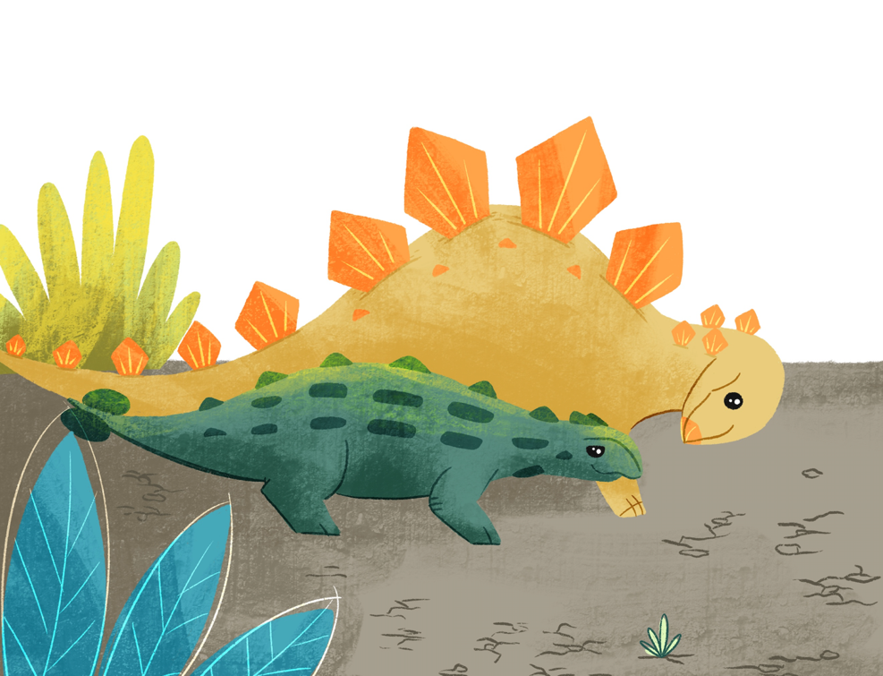
Now, what Dinosaurs are Spiky (yellow) and Stegs (green)?

Slide 15
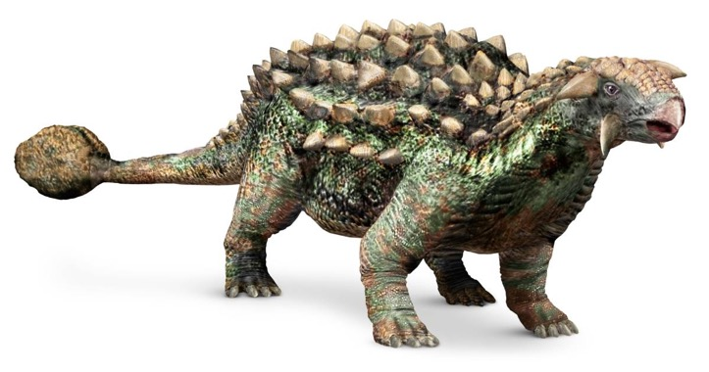
Spiky is a Ankylosaurus!
They were herbivores - they only ate plants, and lived at the end of the Cretaceous period.
They had a vicious tail with a club at the end which they could use as a weapon.
Its name means "stiffened lizard": they had armoured plates and spikes.

Slide 16
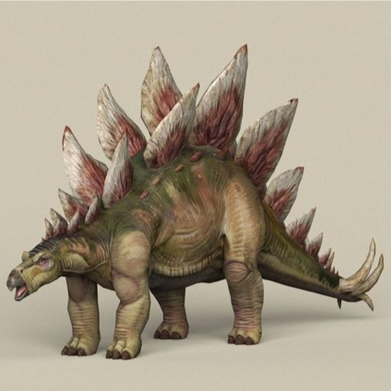
Stegs is a Stegosaurus!
Stegosaurus' were 4 tons. But they had a brain the size of a walnut.
They ate rocks to help mash up all of the greens they ate! Or maybe they were just silly from having such a small brain? Who knows!
They lived in the USA and Portugal in the Late Jurassic period

Slide 17
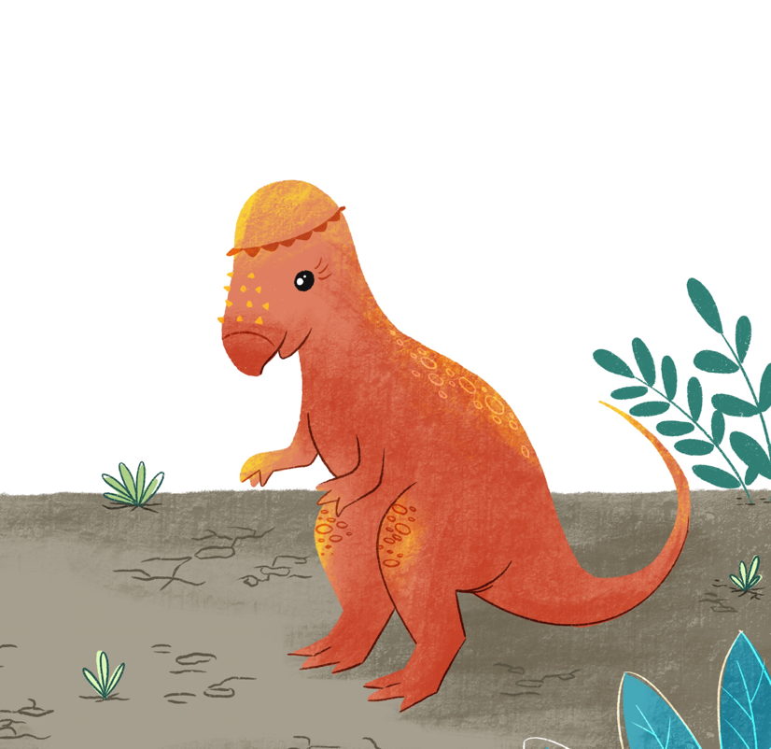
What is Spiny ?

Slide 18
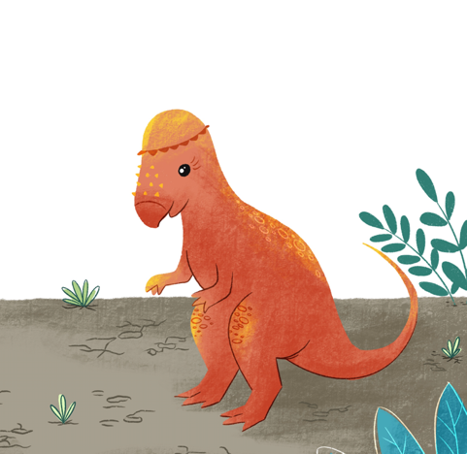
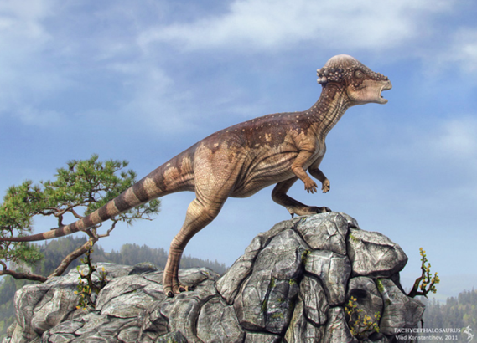
Spiny is a Pachycephalosaurus (what a mouthful)
Their name is pronounced pachy-ceph-alo-saurus
They lived during the Late Cretaceous Period in what is now North America!
Their skull is 30 times thicker than a human skull! They may have fought with their heads.
They were 15 feet long likely weighed around 900 pounds

Slide 19
Watch out… here comes the T. Rex!

Slide 20
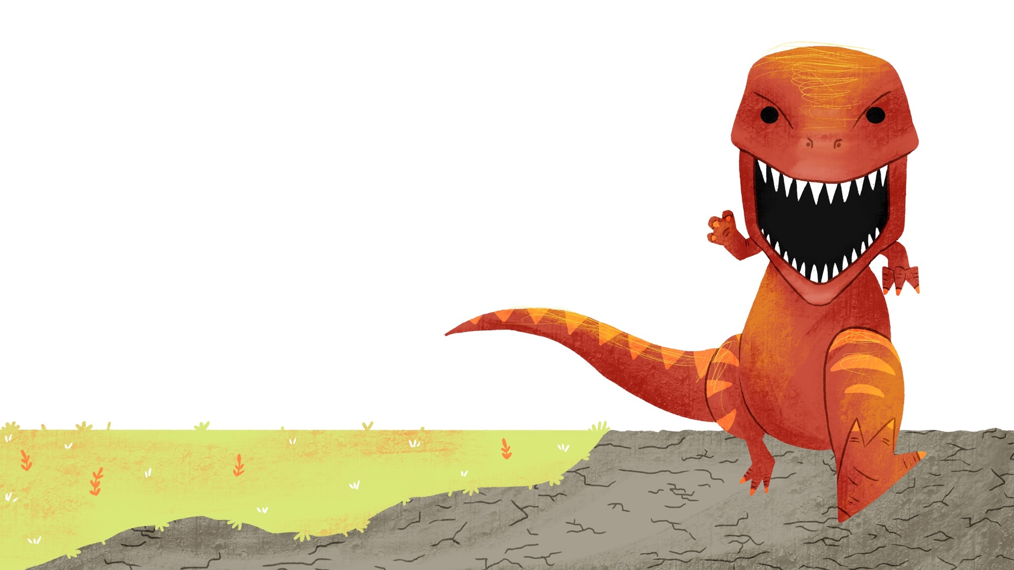
No need to ask what Dinosaur the T. Rex is…

Slide 21
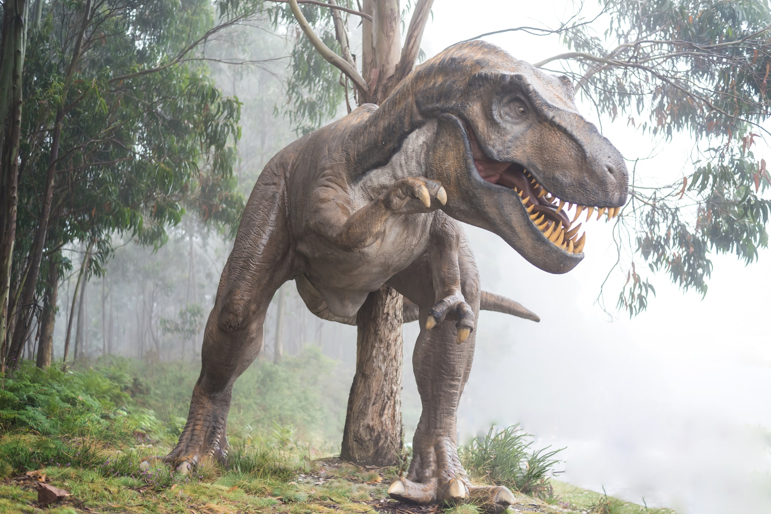

Slide 22
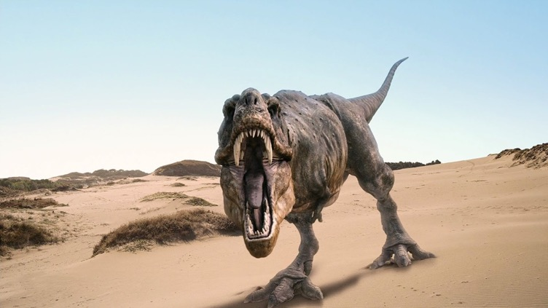
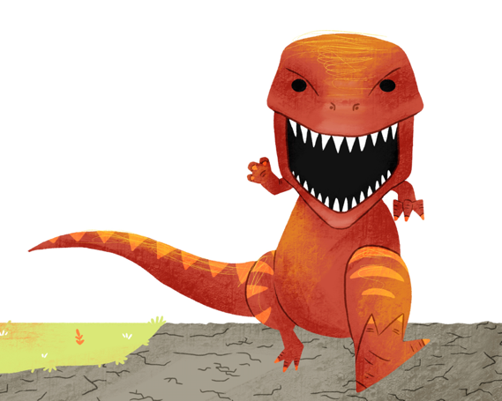
Facts about the terrifying T. Rex!
It was not the biggest meat eater, the Spinosaurus was! They luckily never lived at the same time or place… The T. Rex lived in the Cretaceous Period.
Females were bigger by the males by a few thousand pounds!
Their young may have had feathers.

Slide 23
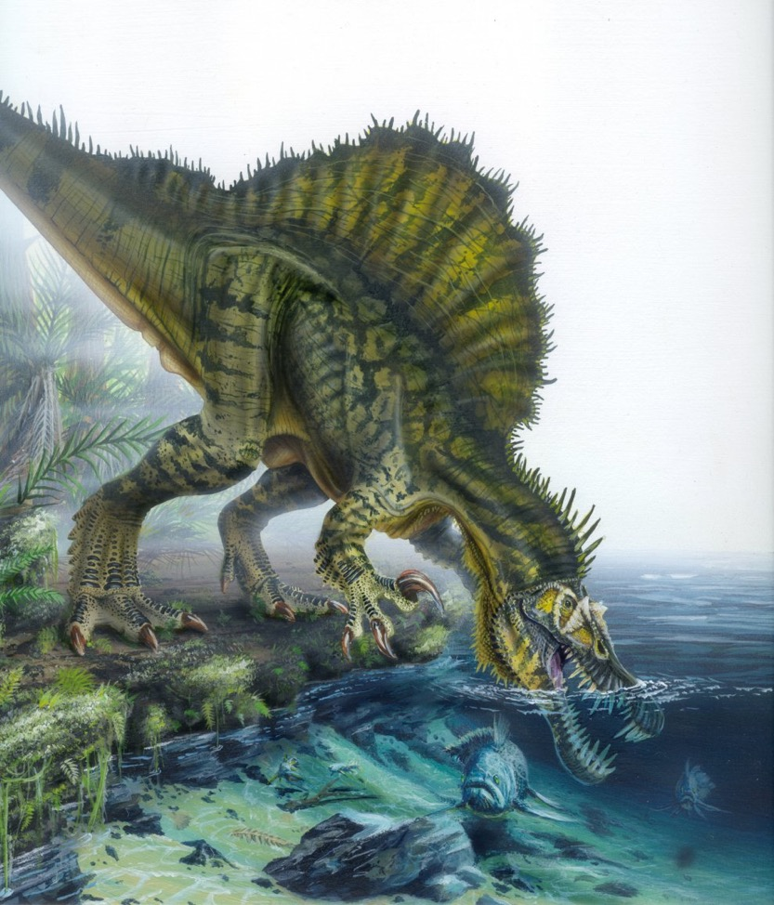
Just so you know this is what the Spinosaurus looked like…

Slide 24
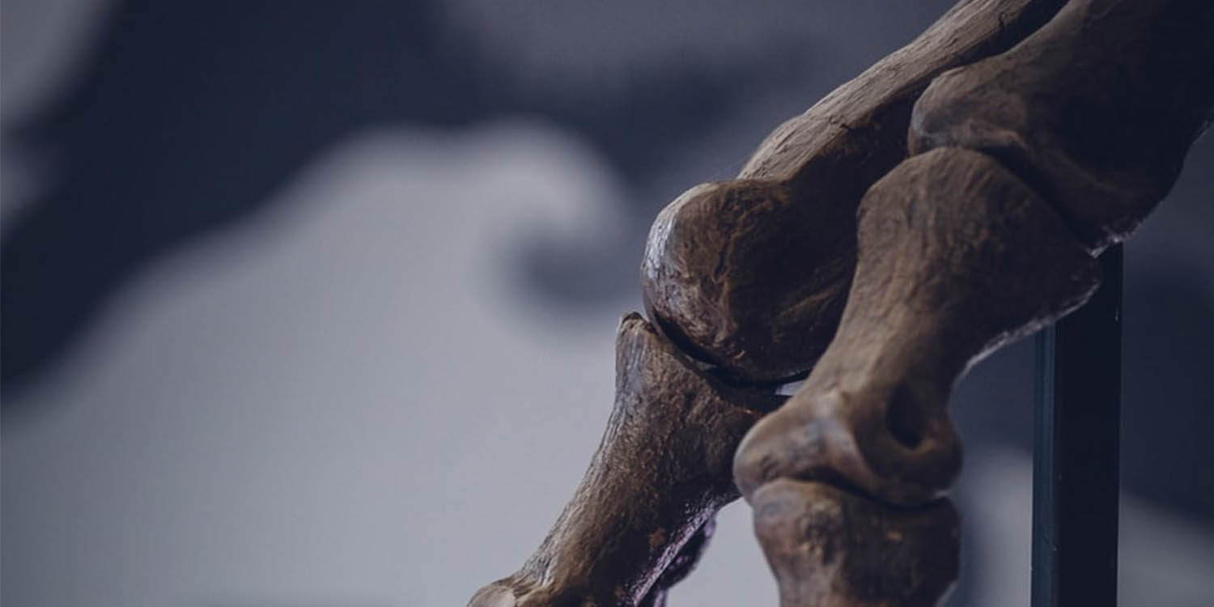
COMMON DESTINY
Dinosaurs were finished off by climate change and meteorites. These brought a lot of cold weather so nothing would grow.
As some of you may know, we are also facing a climate emergency.
We can help to prevent climate change by:

Slide 25
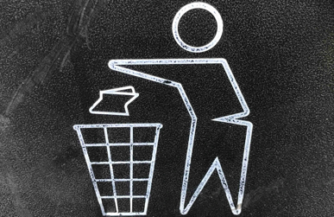
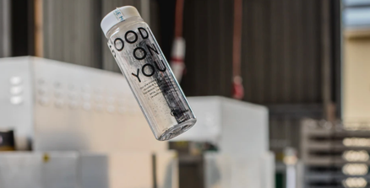
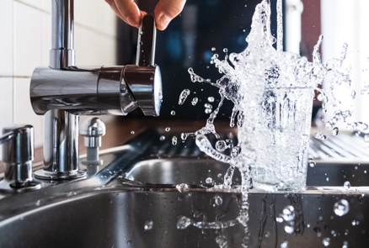
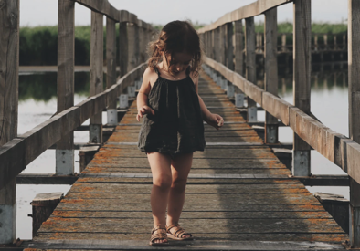
Recycle as much as you can!
Use a reusable water bottle,
coffee cups and straws!
Turn off lights when you don’t
use them and turn the tap off when
you brush your teeth
Walk, cycle or use public transport
rather than drive.

